Slide 1




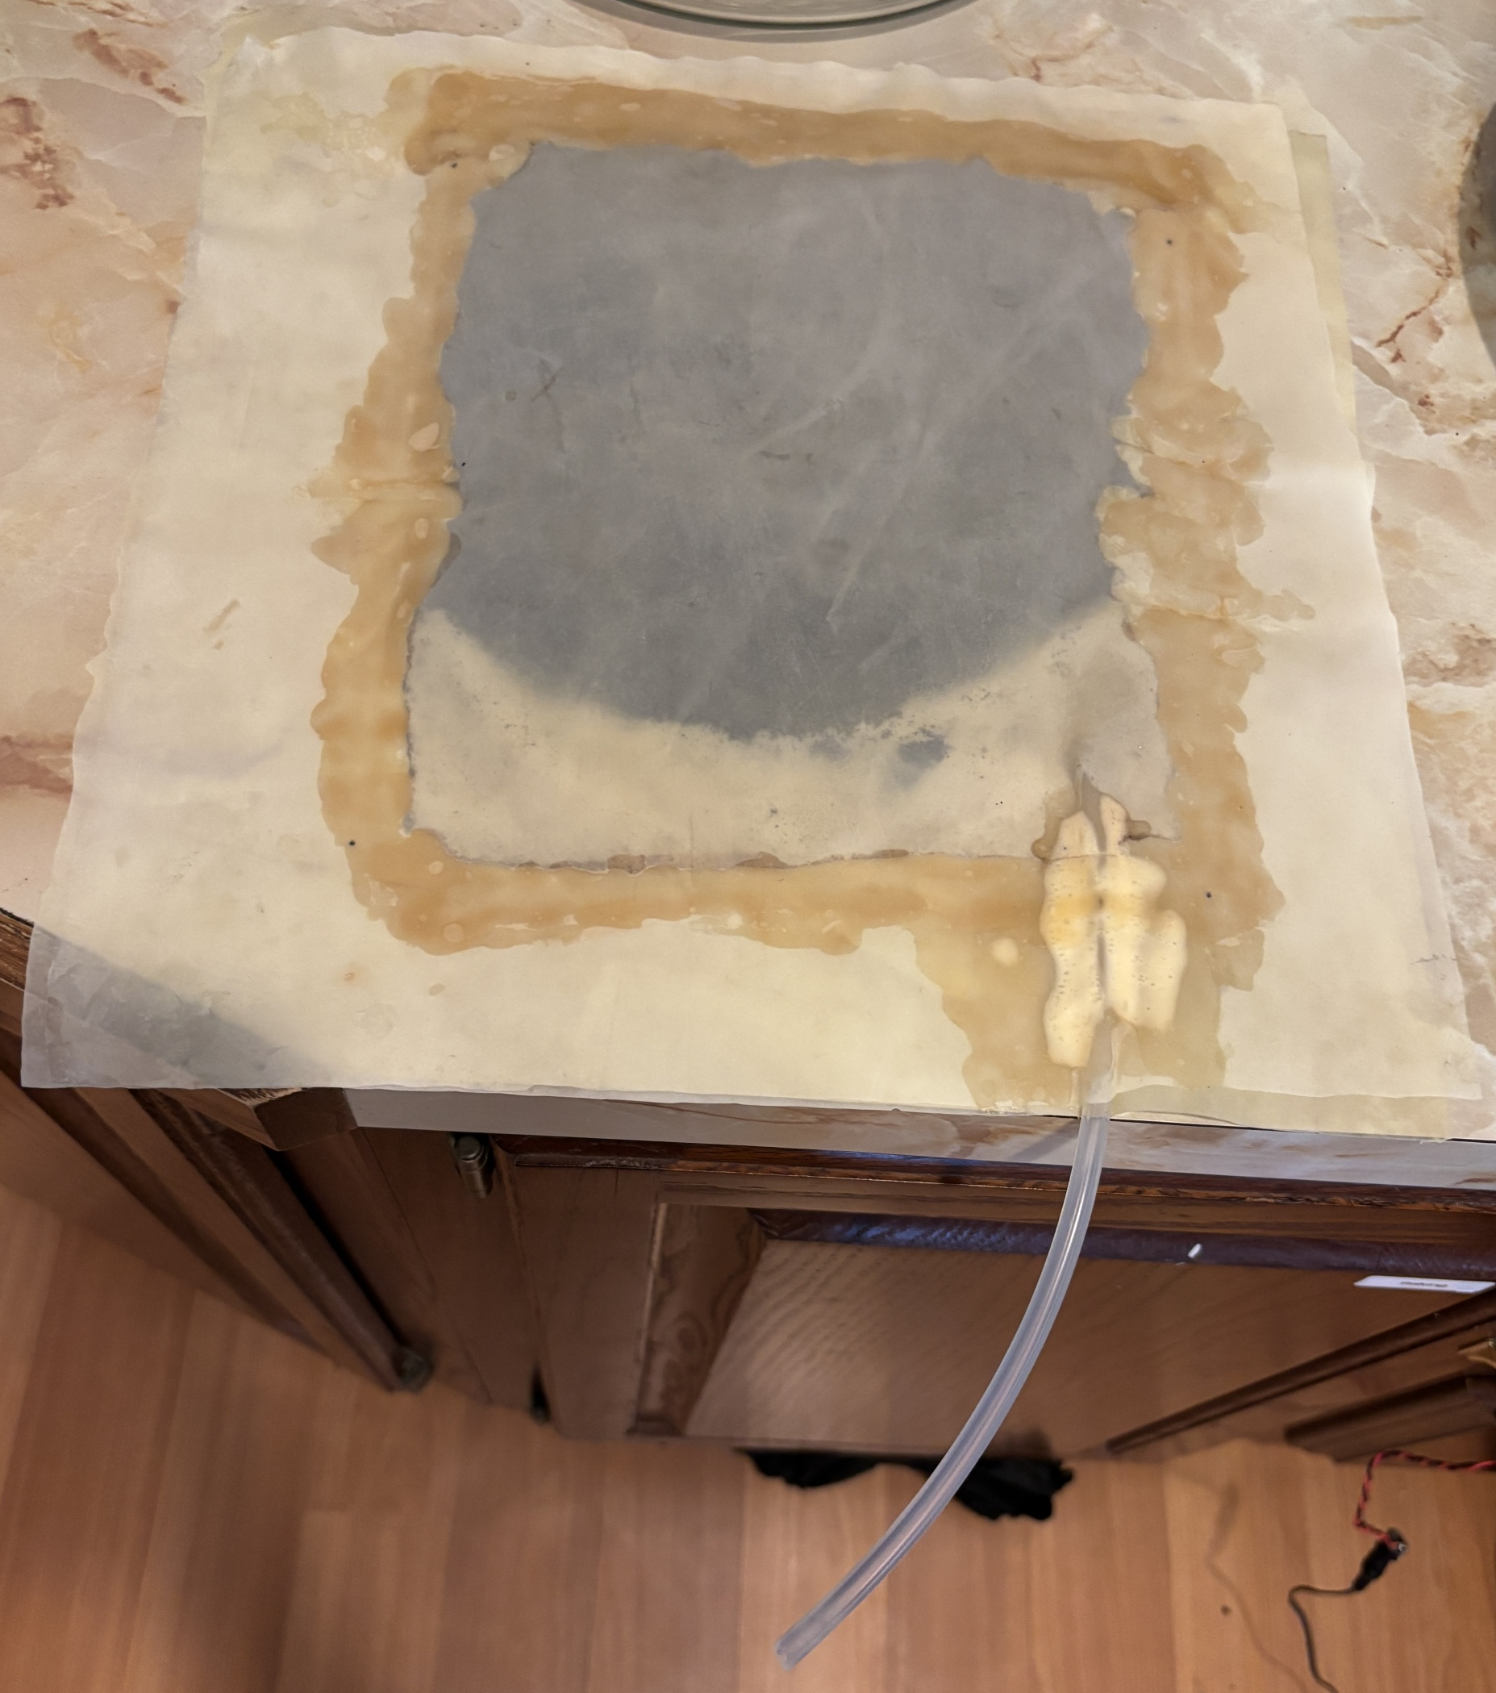
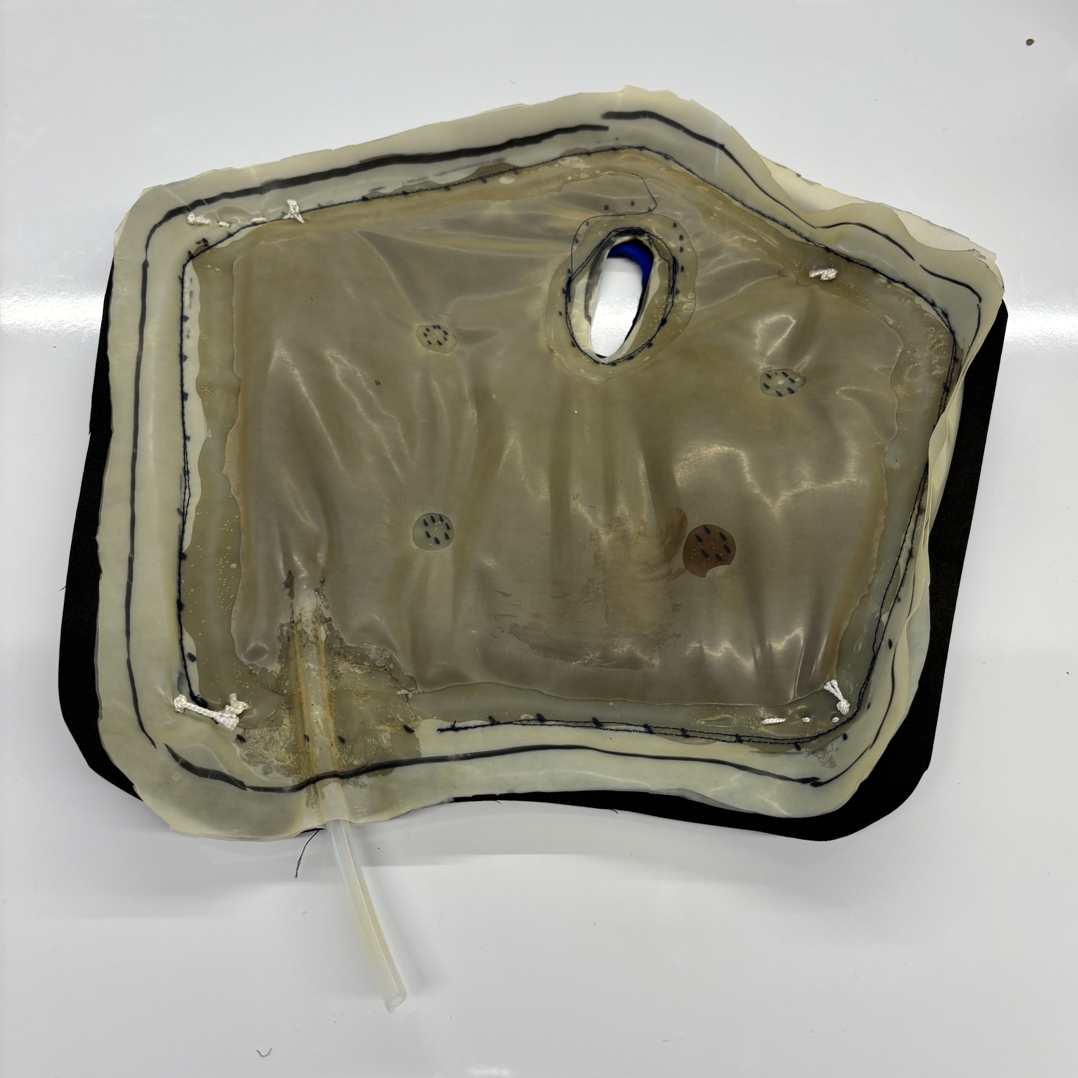
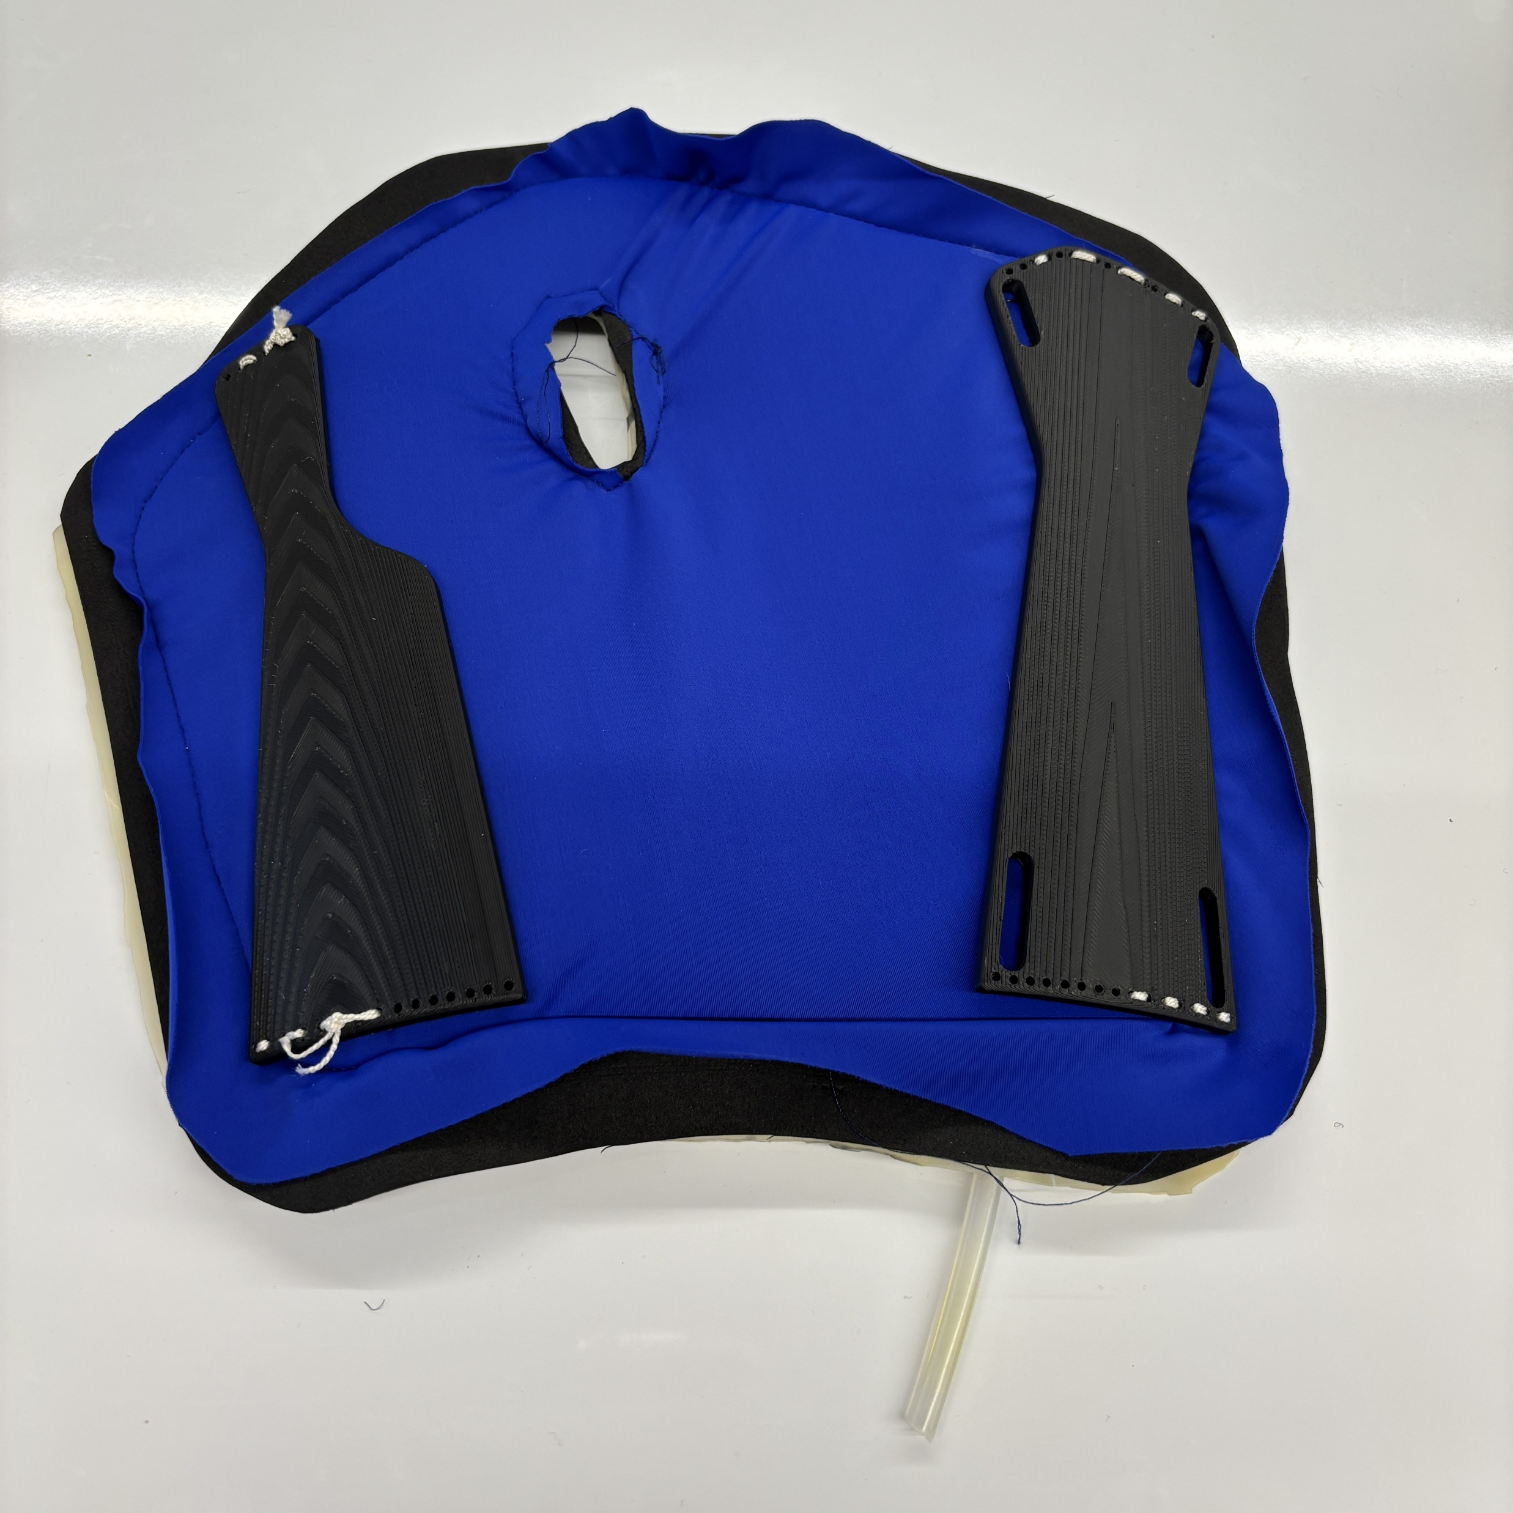
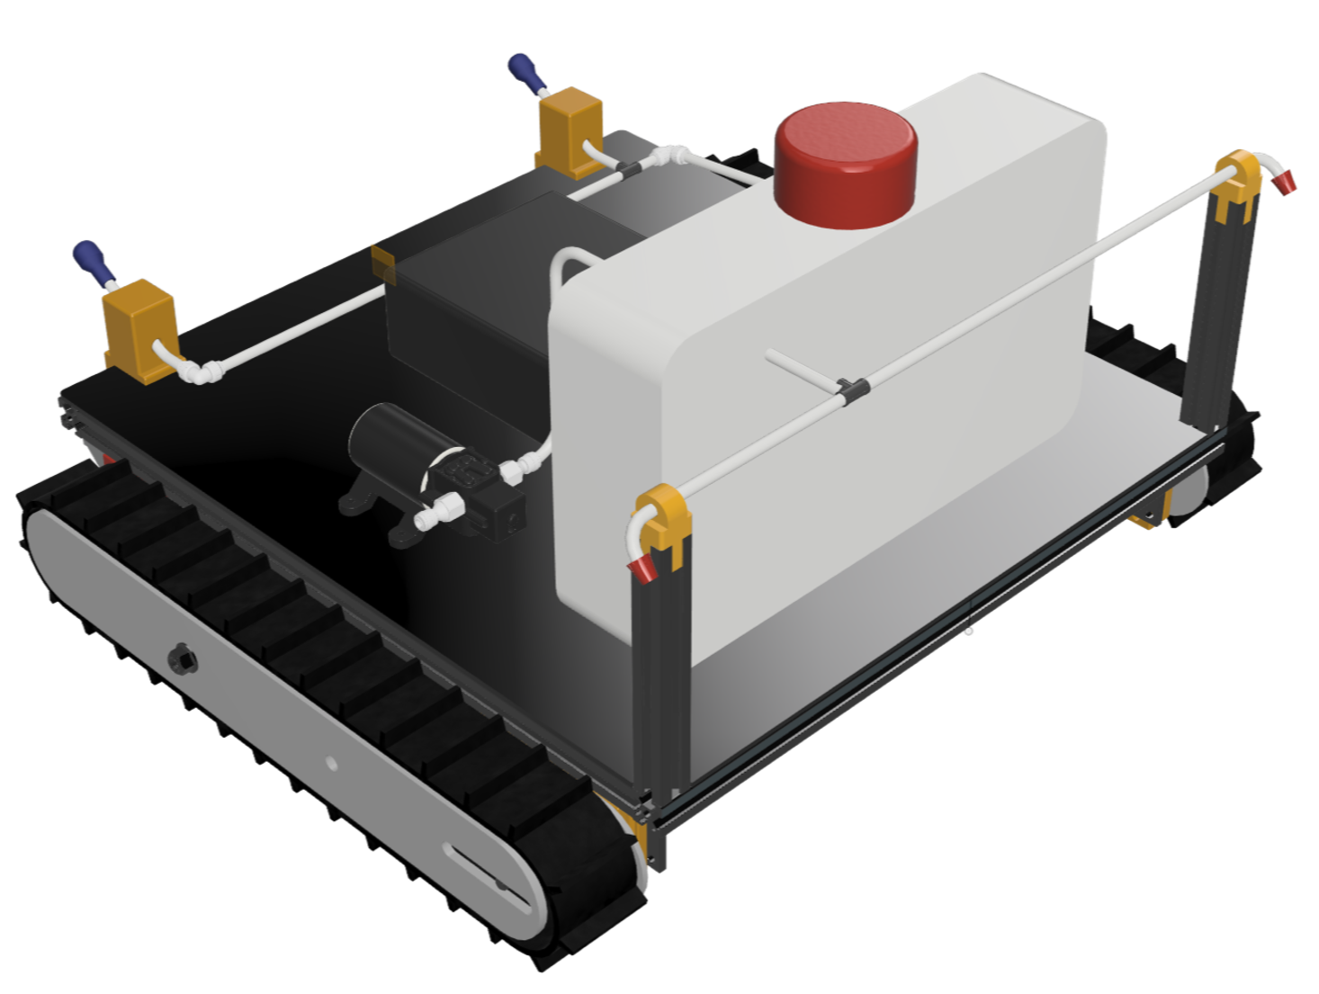
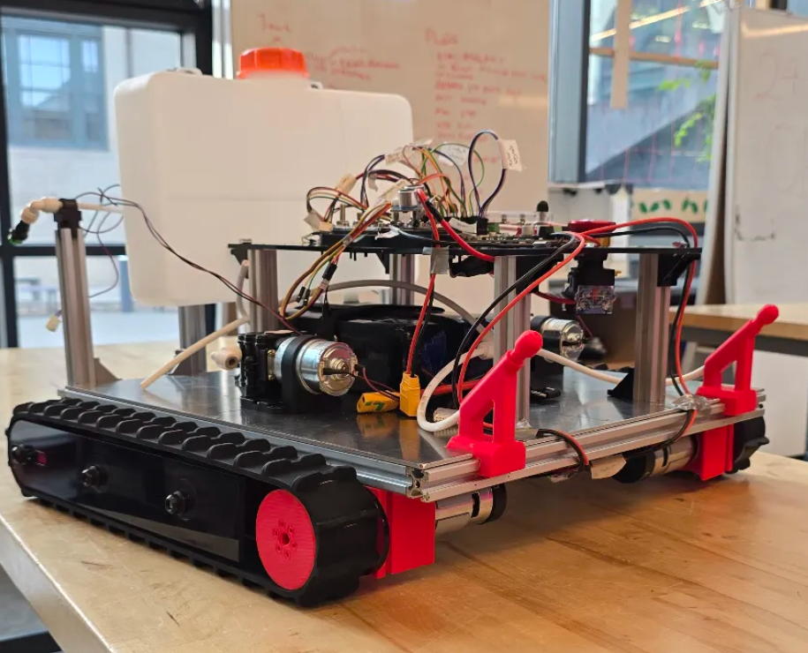
MANDY RAFFERTY
MECHANICAL ENGINEERING AT CARNEGIE MELLON UNIVERSITY
(412) 342-8962
mraffert@andrew.cmu.edu
linkedin.com/in/mandyrafferty
mandyrafferty.github.io
Granular Jamming Wrist Brace
What?
Design and fabricate a wrist brace that uses granular jamming to improve traditional casts
Perform initial research to analyze customer needs
How?
Prototyped a four-layer cast to maximize user comfort
Conducted three-point bend tests on jamming layer to evaluate cast mechanical properties
Results
The Young’s modulus of the design increased by approximately 47 times when in the rigid state compared to the soft state
Rigid state demonstrated improved impact resistance
Semi-Autonomous Salt Spraying Robot
What?
Develop a mechatronic system that addresses labor-intensive application of de-icing materials in harsh winter weather
How?
Translated customer needs into product specifications to ensure final product met expectations
Created a decision matrix to finalize the most optimal design concepts to implement
Results
Developed a semi-autonomous de-icing robot with remote-controlled operation through a Bluetooth-connected interface
Final product featured: obstacle detection, stair coverage, ground coverage, ability to traverse slopes, and emergency stop

Slide 2
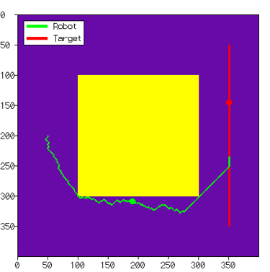
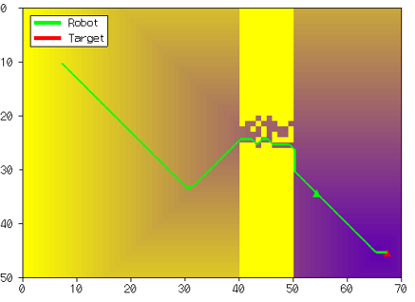
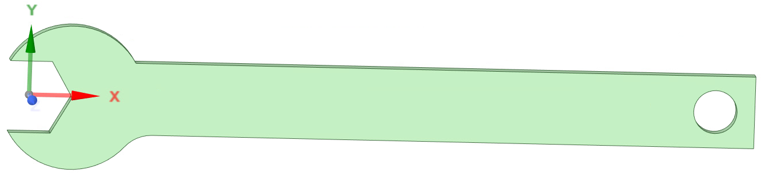
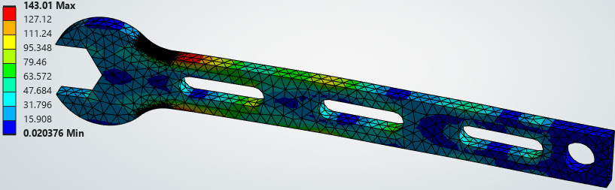
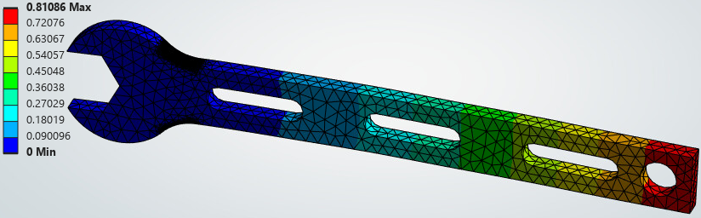
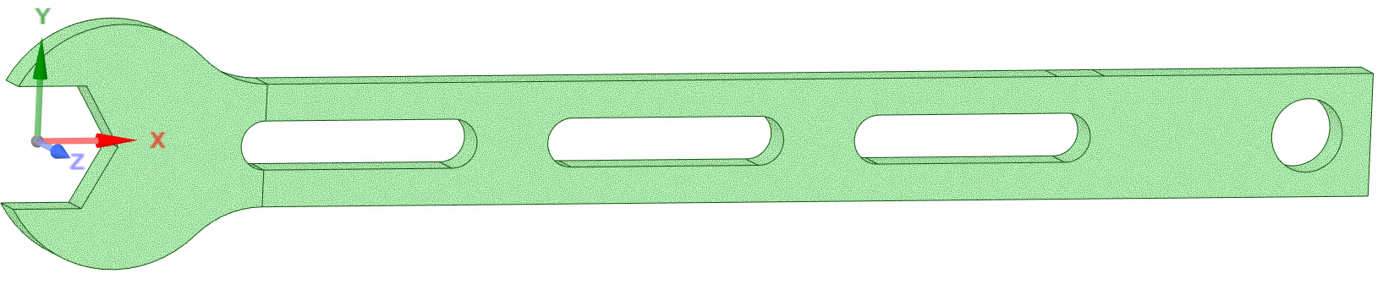
MANDY RAFFERTY
MECHANICAL ENGINEERING AT CARNEGIE MELLON UNIVERSITY
(412) 342-8962
mraffert@andrew.cmu.edu
linkedin.com/in/mandyrafferty
mandyrafferty.github.io
2D Robot Trajectory Visualizer
What?
Work collaboratively in a team with four other people to create individual C++ source files to generate a graphic user interface that could plot the movements of a single point robot
How?
I created the Map Visualizer, which inputs the 2D map data vector and dynamically sizes the grid that the map needs to be visualized on
Team members integrated their components together
Results
Created a program that reads a simple point robot trajectory and visualizes a cost map
Optimal Design of a Bike Wrench
What?
Optimize the design of a bike wrench to minimize mass while ensuring that maximum stress remains below 160 MPa and total deformation is under 1 mm
How?
Using Ansys, parameterized the fillet radius and thickness, then analyzed their effects on stress, deformation, and mass
Performed response surface optimization and design of experiments to determine the optimal parameters
Results
Successfully minimized weight and met design objectives

Slide 3
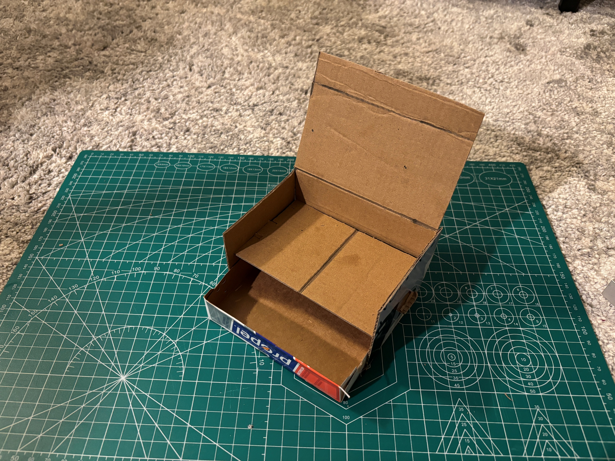
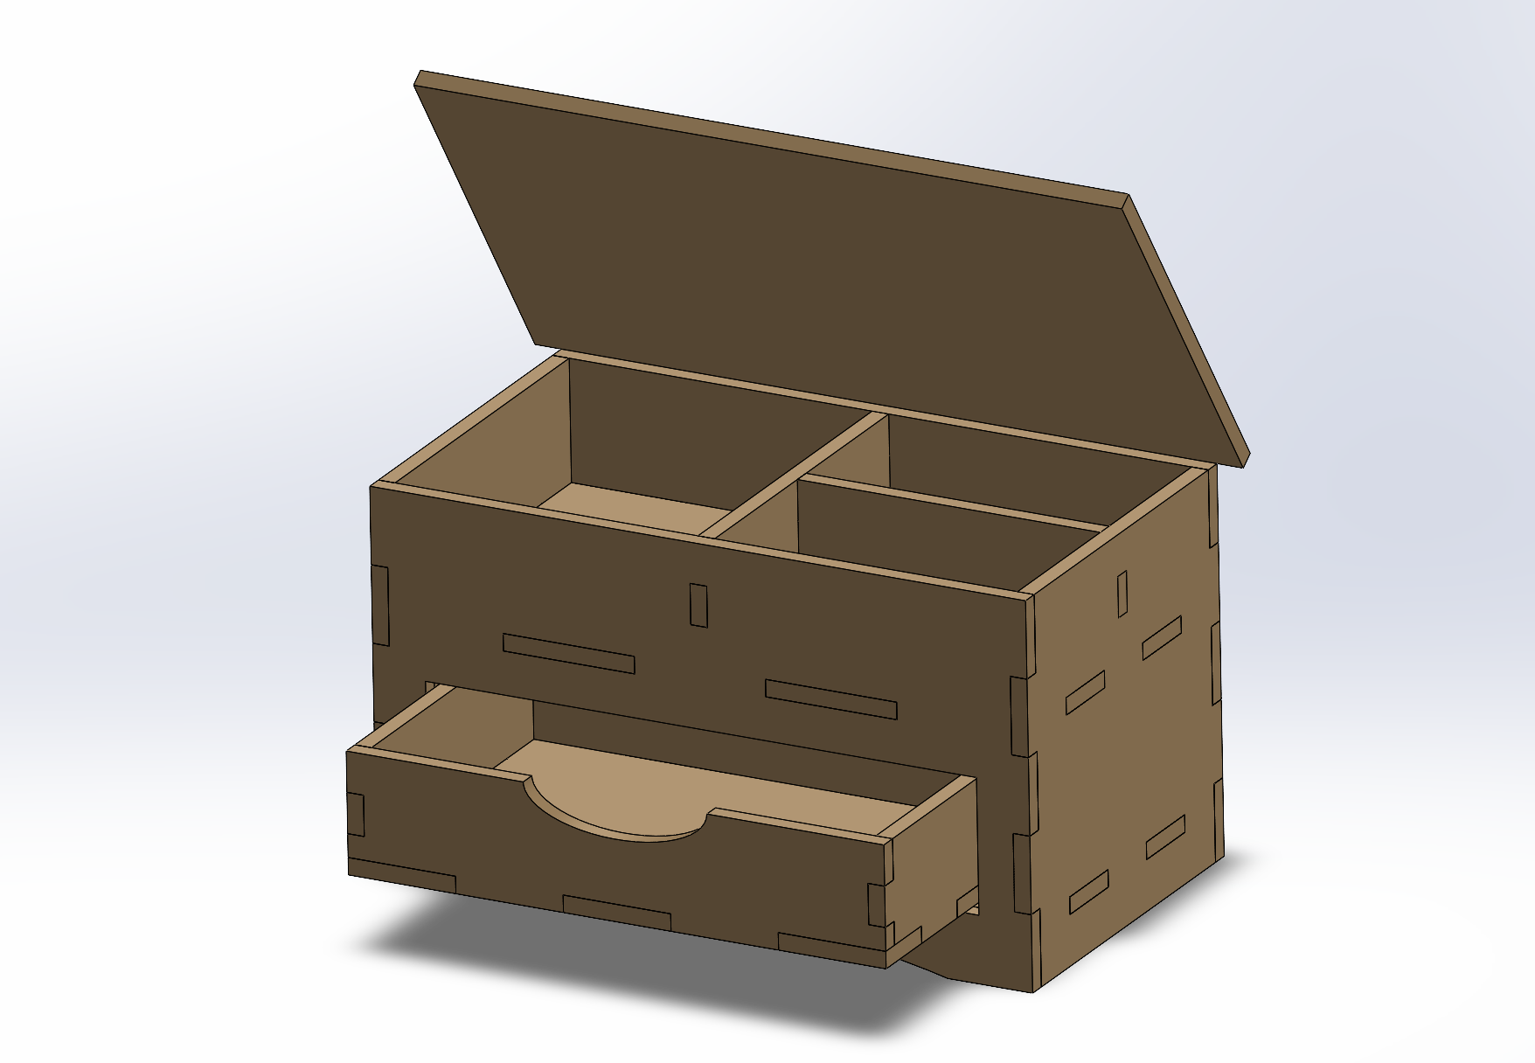
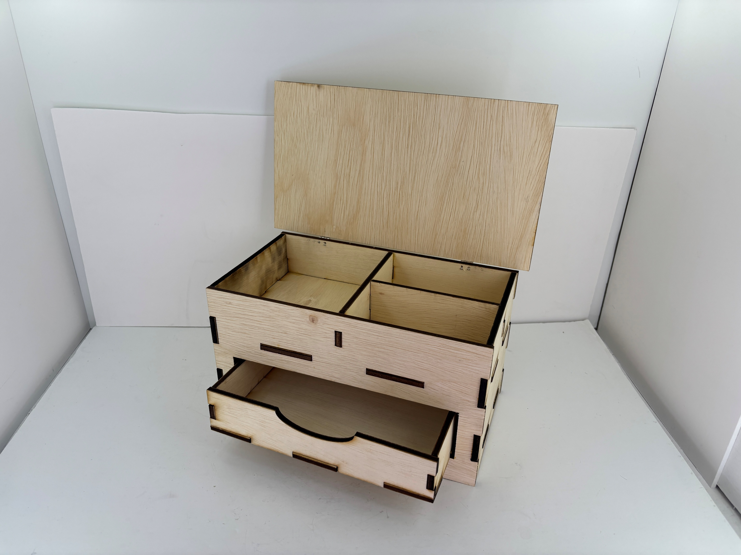
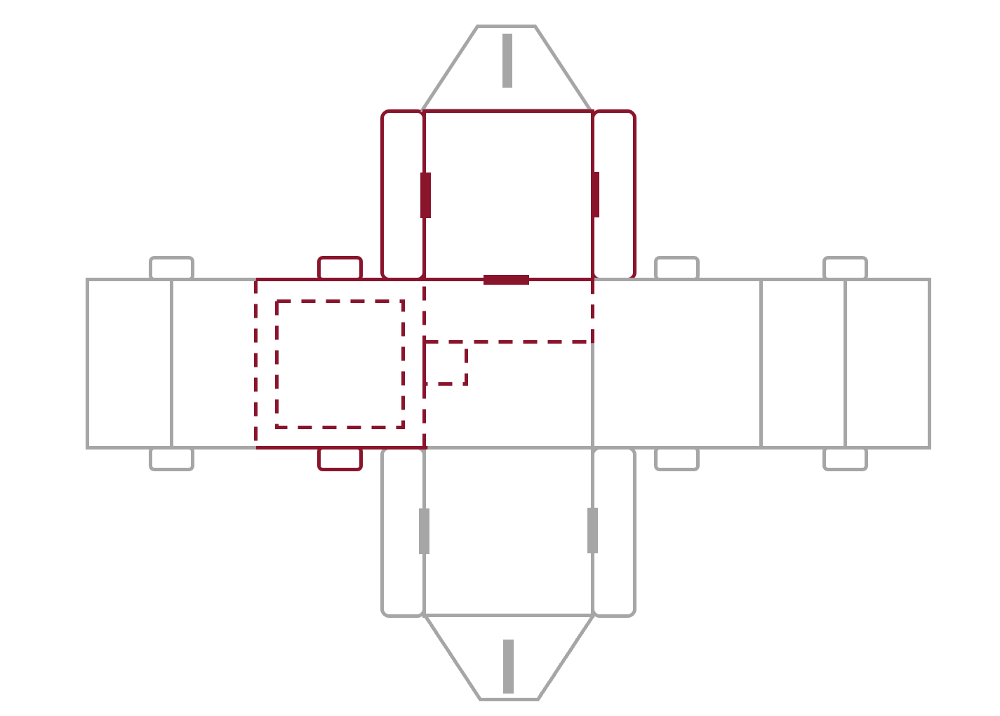
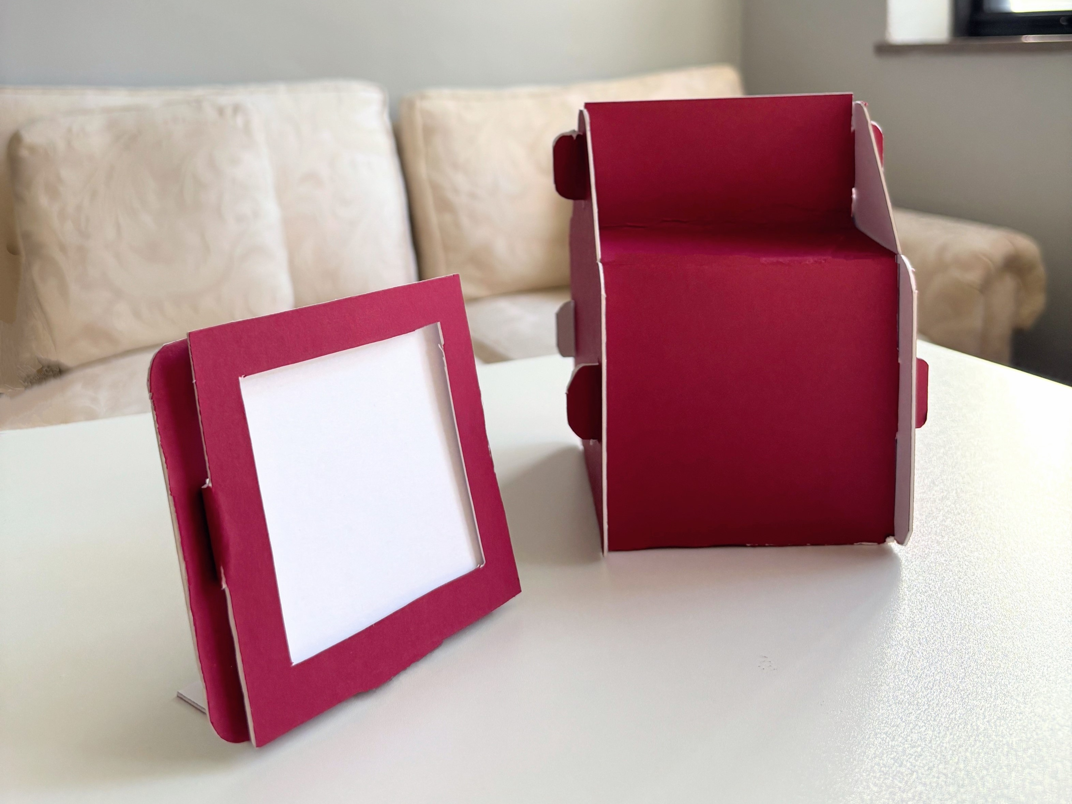
MANDY RAFFERTY
MECHANICAL ENGINEERING AT CARNEGIE MELLON UNIVERSITY
(412) 342-8962
mraffert@andrew.cmu.edu
linkedin.com/in/mandyrafferty
mandyrafferty.github.io
Jewelry Box
What?
To fabricate a product of your choice that makes you or someone else happy
How?
Created a cardboard prototype to test design concepts
Developed a CAD assembly in SolidWorks to ensure pieces fit together and to create files for laser cutting
Results
Designed a jewelry box with a multiple compartments for organization with dimensions small enough to be portable
Multi-Purpose Packaging
What?
To design and fabricate a dual-purpose container that can transform from a takeout box (or similar container) into a secondary useful object without requiring additional tools or adhesives
How?
Conceptualized multiple design ideas through sketching and prototyping
Created rough prototypes from paper and cardboard
Results
Designed a gift box than transformed into a picture frame
Tool-free assembly utilizing a tab and slot mechanism
Eco-friendly construction using only paper materials without adhesives

